Slide 1
LatentView Capability Demonstration
November, 2018

Slide 2
Agenda
1
LV Overview on Data Driven Decision Making
2
Integration of Data from Multiple Sources for a Unified View
3
Case Studies

Slide 3
LV Overview on Data Driven Decision Making
LatentView Confidential

Slide 4
Enabling the data driven decision making journey by…
…getting the data together
…making sense of the data
...applying AI & ML to drive impact
Data Acquisition
Acquiring & consolidating the disparate data sources.
Data Engineering
Integrating various forms of data into centralized data lake using on-premise & cloud based technologies
Data Processing
Process various forms of disparate data – Structured, Unstructured, Physical, Human Interactions, Machine Generated, Real Time etc
Graph Analysis
Exploration of frequency, strength and direction of relationships & Causalities.
Exploratory Analysis
Deep insights from all forms of data using traditional methods (Segmentation & Clustering)
Natural Language Processing
Analyze dimensional insights & relationships by automated tagging
Real Time Analytics
Experience in sub-second big data processing for real time applications
Deep Learning & AI
Self governing systems leveraging AI & eliminating manual intervention
Machine Learning
Deep experience with various machine learning algorithms, including Ensemble Learning, Neural Networks, etc.

Slide 5










1. Getting the data together
How to acquire data?
How to create a unified data view?
How to enable consumption?
Structured Data
External / Internal
Customer Data
Web Data
Data Integration
METRIC & EXCEPTION
REPORTS
Marketing Data
Structured
Payment Data
Data store pipelines enables metric & exception reporting
App Data
INTERACTIVE VISUALIZATON
Data Lake
Dispute Information
API endpoints enabling integration with
other systems
OPERATIONAL
Unstructured Data
External / Internal
Voice Data
Unstructured
ML / AI Workbench for
Prediction & Insights
Chat Data
ADVANCED
ANALYTICS
Email Data
Biometric Data
Social Data
Other data sources

Slide 6
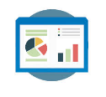




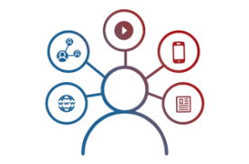


2. Making sense of the data
Reporting & Visualization
Performance Management, KPI Measurements
Monitoring & Control
Real Time Assurance, Audit & Compliance
Voice of Customer
Criticalities, Competitive Intelligence
Segmentation & Clustering
Personalization, Appropriateness etc.
Relationship & Causalities
Implementation, Strategy &
Prioritization
Digital Analytics
Consumer Journeys, Marketing Effectiveness
Experimentation
Experimentation at scale, A/B testing etc.
Integrated & Disparate sources in Data Lake

Slide 7

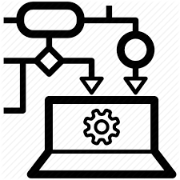

3. AI / ML to drive business impact
Business Planning
Demand Prediction
Market Strategy
Strategic Investments
Early Warning Alerts
Customer Complaints
Transactional Risks
Loss Prevention
Innovation / Insights
Voice of Consumer
Competitive Intelligence
Product Governance
Customer Engagement
Personalization
Acquisition & Conversion
Customer Experiences
Self Serve Analytics through Micro Applications
Complex Data Linearly Scalable With Data Volume
Faster Time To Market Due To Less Set Up Time
Artificial Intelligence / Machine Learning
Integrated & Disparate sources in Data Lake

Slide 8
Integration of Data from Multiple Sources for a Unified View
LatentView Confidential

Slide 9



Integrating Data from Multiple Sources
Key questions that need to be addressed
1
2
3
How to acquire data?
How to create a unified data view?
How to enable consumption?
Identify the correct tools to combine data from different sources based on the data type
Prioritize between clouds based platform vs an on premise data lake creation, based on business requirements
Enable support for Visualization or Machine learning techniques like Forecasting, clustering and other advance analytics

Slide 10


Integrating Data from Multiple Sources
How to acquire data?
How to create a unified data view?
How to enable consumption?
Data Integration
CANNED REPORTS
Conventional Data Sources
Structured
SELF SERVICE BI
Unconventional Data Sources
Data Mart / Data Lake
OPERATIONAL
External Data Sources
Unstructured
ADVANCED ANALYTICS
Internal Data Sources
REAL TIME REPORTING
Data Type specific ETL toolset
Workload Aware Compute

Slide 11
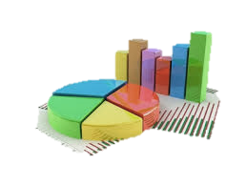
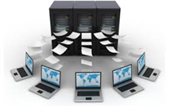
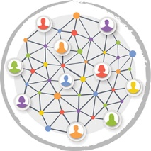




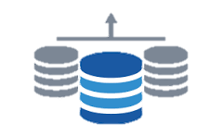
Integrating Data from Multiple Sources
DATA COLLECTION
DATA HARMONIZATION
DATA VISUALIZATION OF KPI’s
Data is collected from multiple sources that are required for the development the required dashboards / reports :
Internal Data
External Data
All the collected data from different sources are loaded in the form of a data mart / data cube. This can be done in one of the following two ways :
In House Data Base
Using Cloud
Visualization of the requested KPI’s can be developed in any of the listed platforms which will enable comparison of multiple channels and summary of performance metrics :
Tableau / Domo Dashboard
Excel Report
Web Tool

Slide 12







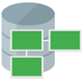



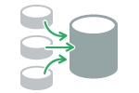

LatentView Solution for Refining Reporting Structure
Review of KPI’s
Audit Current Reports
Design Wireframes
Data Integration
Schedule user interviews, prepare list of existing reports, their data sources, business users and KPIs
Understand data sources, data flows
Understand detailed wireframe requirements
Define architecture for the data integration layer
Identify business objectives
Understand logical grouping of reports
Iterate on wireframes and review with potential end users
Design the data model for the analysis data mart
Define KPI’s required vs used, and goals
Identify usability and audience for each report to capture business value
Prioritize wireframes based on business needs and complexity of implementation
Recommendations on Data Integration process for report deployment on pentaho
Net difference: Promoters vs. Detractors
18%
Identify gaps in KPIs & segments in the context of current reports
Recommend a new set of reports that helps achieve the objectives

Slide 13
Case Studies
LatentView Confidential

Slide 14
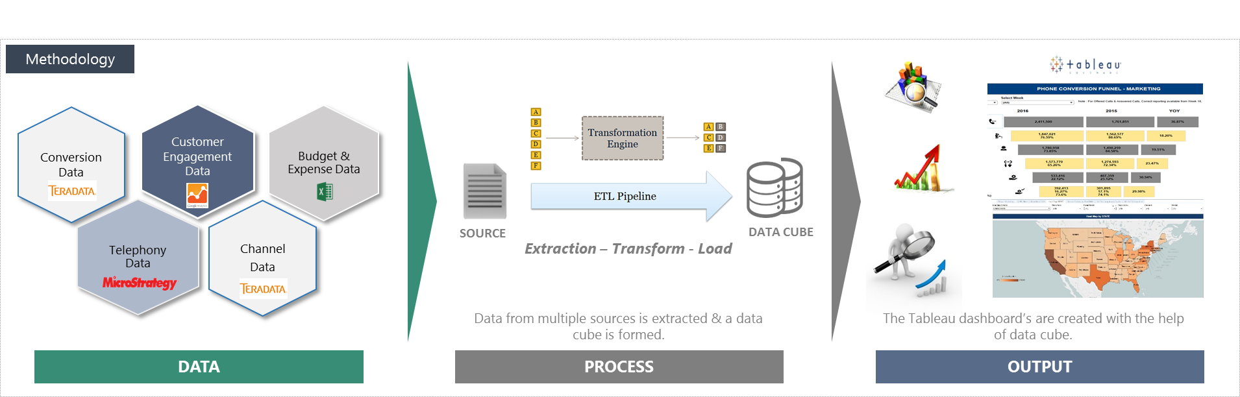
One Stop Conversion Funnel Dashboard from Multiple Sources
Leading Home Appliance Repair Service Provider in US
The “Before” State
Clients were in needs of a visualization solution for the Marketing & Non Marketing channels
To enable descriptive analytics and provide Visualization solution for Marketing team and to help in Strategic decision making
LatentView Solution
Created a data lake by extracting data from multiple data sources and developed tableau dashboard’s & reports tracking the conversion funnel
The dashboard provides Marketing KPI's at a channel level across geographies on a weekly basis comparing YoY performance.
The “After” State
The Conversion funnel helped in understanding the flow of business and identified bottlenecks & areas of concern
The Marketing team understands the business trends and seasonality of various Channels across geographies

Slide 15
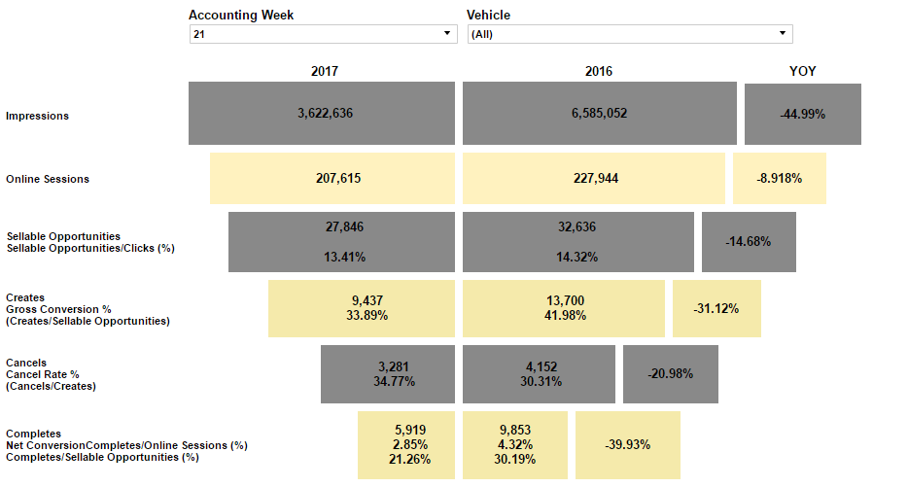
One Stop Conversion Funnel Dashboard from Multiple Sources
Marketing Funnel Dashboard for a Leading Home Appliance Repair Service Provider in US

Slide 16
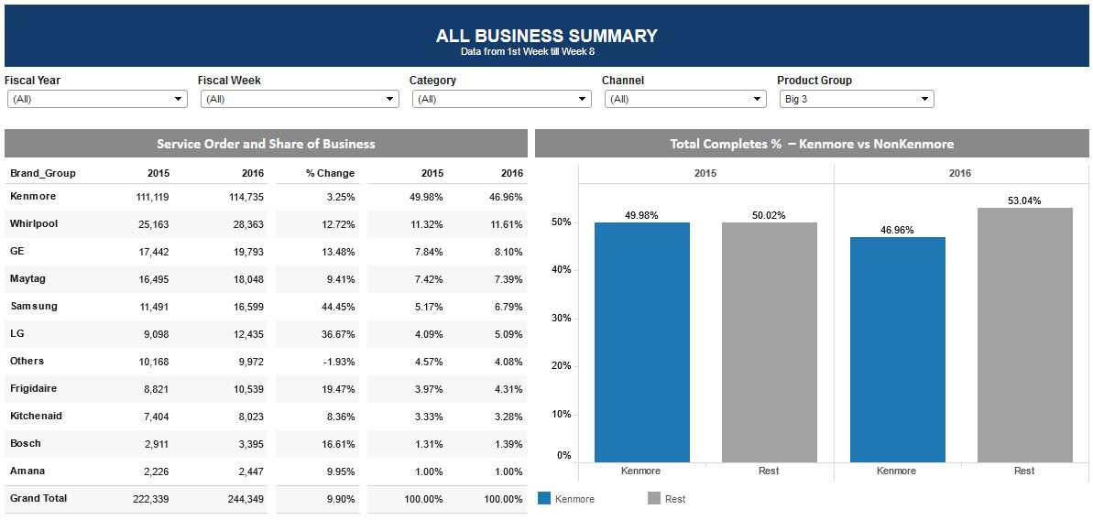
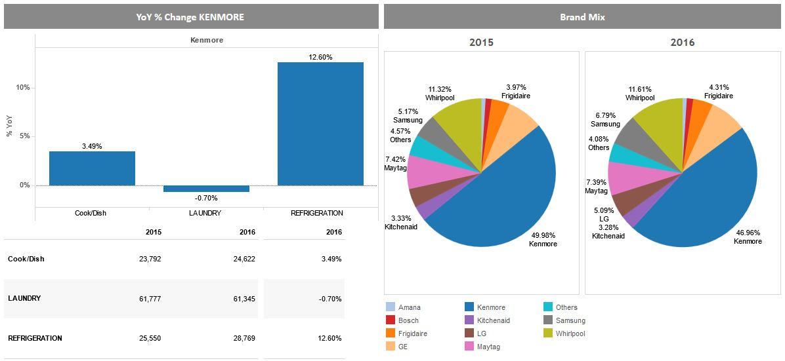
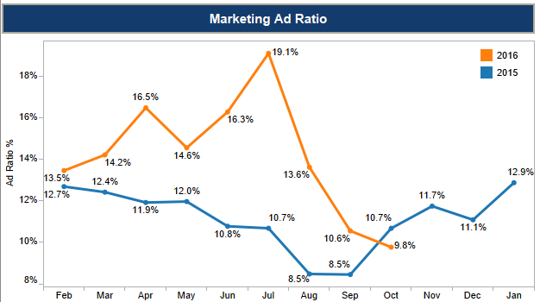
One Stop Conversion Funnel Dashboard from Multiple Sources
Marketing Funnel Dashboard for a Leading Home Appliance Repair Service Provider in US
Effective filters to interact and make dynamic reports
Tracking the right KPI’s for the audience
Summary at an overall level for Executives
Drill Down to get insights

Slide 17
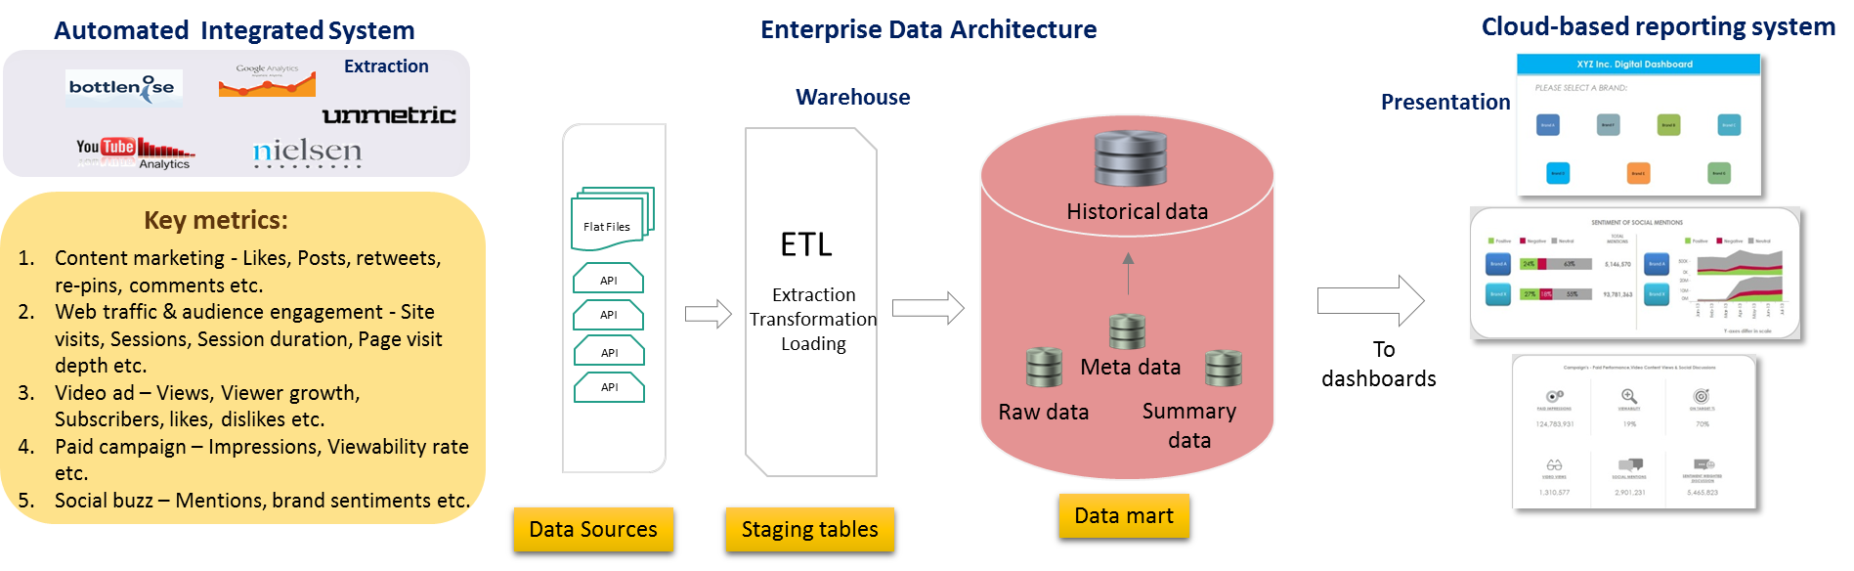
360-Degree View of Digital Metrics to Improve Marketing Effectiveness
Leading Global Food & Beverages Corporation
The “Before” State
In the CPG industry, lack of a unified view of marketing data can result in incorrect analysis and wrong conclusions
Siloed platforms provided a disjointed view of marketing effectiveness resulting in a protracted test cycle for campaigns
LatentView Solution
Built an integrated dashboard with paid, earned and owned media metrics that facilitates cross-channel, cross-brand and cross-campaign comparison to gain deeper marketing insights
The “After” State
Test cycle for campaigns reduced by 25%, thus resulting in a decrease in cost per campaign by as much as 8%
Notes:
Pepsi - DigiView
Business Objective:
To build a single-viewed automated real-time application that enables CXOs to make quick data-driven insights from a company’s digital & social marketing efforts that cut across their Paid, Earned & Owned media spectrums.
LatentView Solution:
Integrated data from five different data sources and built 11 comprehensive interlinked dashboards that give both a snapshot view and a deep dive view of their trademarks’/brands’ online presence, content marketing messages, customer perception and campaigns’ performance within their portfolio & against their competitors.
Business Benefits:
Automated real-time business intelligence application provided the client an opportunity to view their brands’ social & digital marketing efforts in visually appealing & feature-rich Tableau dashboards.

Slide 18
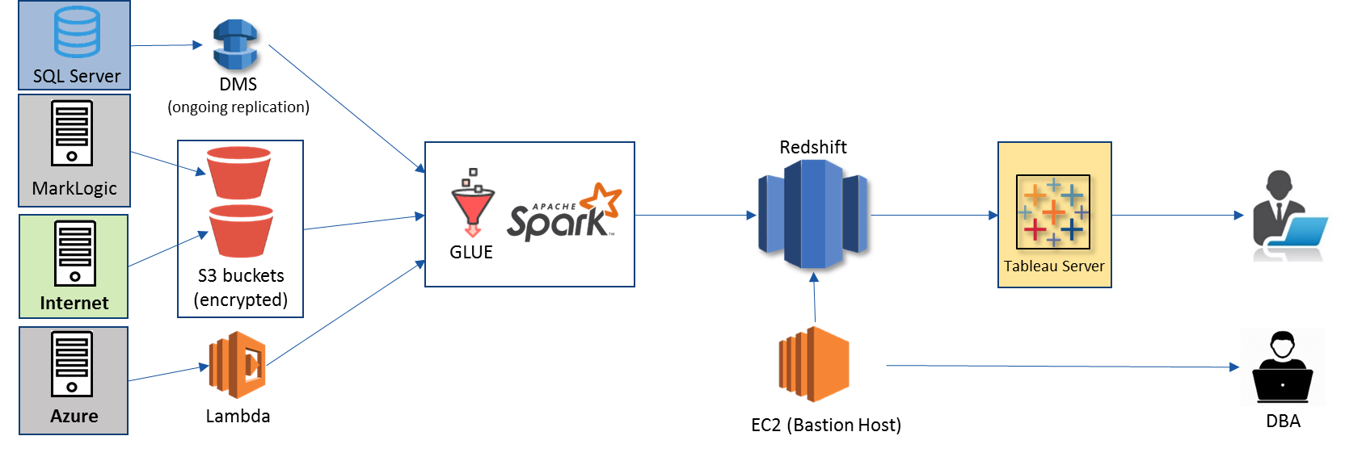
Data Harmonization for Efficient Digital Supply Chain
World’s Largest Entertainment production company
The “Before” State
The supply chain starting from digital content request to going live is tracked using multiple silo data sources and requires skilled executives to monitor for revenue leaks
LatentView Solution
Built an data ecosystem from multiple disjointed unstructured and structured data sources by leveraging AWS cloud platform for big data, thus providing a monitoring platform
The “After” State
The solution helped in ensuring on-time delivery of the digital contents and thus, saved half a million dollar per year from revenue leaks
Notes:
Warner Bros – Digital Supply Chain (Data Engineering)

Slide 19
Appendix
LatentView Confidential

Slide 20
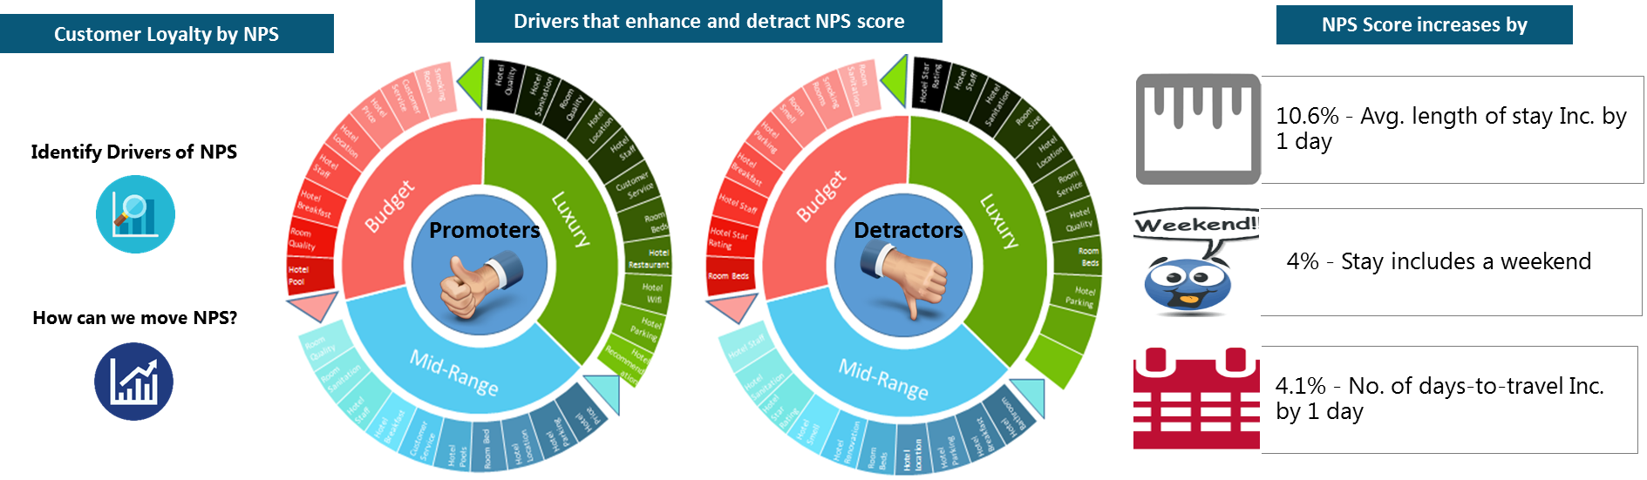
Driving Customer Loyalty through Net Promoter Score (NPS) Analysis
US-based Leading Travel Website
The “Before” State
Given the high customer acquisition cost in the highly competitive online travel industry, establishing & nurturing customer loyalty can lead to higher profits
Insights in to extent of customer loyalty in the OTA space was limited and the levers to move customer loyalty were not known
LatentView Solution
Identified the drivers of NPS by performing text mining on post purchase surveys and quantified the influence NPS drivers on customer loyalty using regression approach
The “After” State
Based on NPS drivers analysis, company revised hotel ratings, improved results sorting & re-focused marketing promotions which resulted in 15% increase in repeat transactions from existing customers
Notes:
Hotwire- NPS
Business Objective:
Identify the drivers for NPS score and the impact of NPS on repeat purchases
LatentView Solution:
Identified the factors driving NPS by text mining of NPS survey feedback
Identified the drivers of NPS and quantified their influence using a regression approach
Process:
Data collected from post purchase survey Text mining on survey data to identify detractors and promoters for NPS score.
Identified the drivers of NPS and quantified their influence using a regression approach
Business benefit: Helped ascertain the importance of the post purchase survey and tracking of customer NPS level
Client used the findings to identify entire neighbourhoods where inventory needed to be improved and build a checklist of features to rate future partners and suppliers
Significant Effect:
Solution provide a potential increase of 15% repeat transactions of the customer

Slide 21



Examples of some of our previous work
Leveraging IOT sensor data to mine insights on driving patterns
Enabling cloud infrastructure to generate real time product recommendations
Improve service levels by leveraging analytics on multiple segments across supply chain
Leading German automobile player
Leading Food distribution company
Leading Home Appliance Repair Services provider
Profile Driver behavior to predict vehicle risks and estimate warranty costs using IOT data
Converge data from silos into a centralized cloud based platform to build a recommendation engine
Enhanced the business performance from existing 45% to 95% service levels that impacted 13 Million Customer Service requests annually

Slide 22
1. Profile driver behavior using IOT sensor data
Solution
LatentView developed and delivered SMART INSIGHTS tool, a scalable and self-service platform for analytics on connected vehicles
TECHNOLOGY State of art open source technologies like Scala, Spark, Data bricks
SCALE Built on 4.5 million cars & 2.8 Million Warranty Claims across multiple geographies
AGILE Delivered under 6 months
INNOVATION Superior analytical capabilities through simplified user experience
Key Highlights
Complexity
IOT Data from cars all over the world, merged with local warranty claims and built Machine learning solution on top of it
Features
Exploratory Analytics
Warranty vs Features
Vehicle Segmentation
Risky Neighbours
Analysis
Connect Product Usage with Warranty Repairs & Features
Predicting Risk for Similar Profiles
“Cars showing Short Trip & Long Pause behavior have a 40% higher chance Engine related failures”
Vehicles that spend 100% more on Pedal position are at a 250% risk of engine related defects.
Sample
Insights

Slide 23



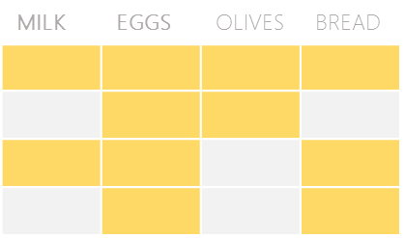

2. Recommendation Engine for food distribution company
The Problem: In an industry where customer acquisition is fairly expensive, this company’s repeat orders were at a low 4%
The “Before” State
LatentView Solution
The “After” State
Sales teams tried to sell new products to existing customers based on shallow analysis of previous transactions and ‘gut’ feel
Build an innovative recommendation engine that combined customer segmentation, user-based collaborative filtering and market basket analysis
20% increase in value of new orders from existing customers. Higher customer satisfaction due to precise recommendations
Collaborative Filtering
Market Basket Analysis
Items Purchased:
Items Purchased:
Market Basket Analysis performed for all products bought by customers in a segment. Select the product with highest likelihood to co-occur in the basket
Similar
Customer B
Milk
Eggs
Milk
Eggs
Bread
Customer A
Customer C
TRX1
Milk
Eggs
TRX2
Recommend Bread
User-User Similarity - similarity is calculated between customers within a segment based on common products in basket using Cosine Similarity
TRX3
Recommended
Bread
TRX4
Recommendation Engine
Combine the recommendations from the 2 algorithms to generate the final recommendation
For a Customer who purchases Milk & Eggs, the product with highest affinity is Bread

Slide 24





2. Scaling up the machine learning solution to Big data
Built a product recommendation system for a leading food distribution company
and later scaled it up to include all 72 op-cos and all geographies leading to ~20% increase in the new orders by existing customers
Phase 2
Big data platform providing Machine learning solutions for 72 op-cos
Phase 1
Enabled Distributed processing and data pipelines for data across geographies
On Premise machine learning solution for 7 op-cos
Custom built cloud based tool delivering insights like:
Recommendation system for cross-sell opportunities (customers & deals)
Next best product recommendation
Data dimensions
Customer Segmentation
Customer
Order Anomaly Detection
Transaction
User Based Collaborative Filtering
Product Substitution
Geography
Market Basket Analysis
Revenue Management Use Cases
Products
Price
Final Recommendations
Real time recommendations
40K customers data
36X faster than linear approach
Serves 72 op-cos across USA

Slide 25

3. Improving Home Service Requests Operational Efficiency
Objective : To enhance the customer service request fulfilment rate from existing 45% to 95% for ~13M Customer Service requests annually
Approach: Disintegrated the business goals into 3 key business processes that needed attention and build a scenario simulation tool
1
2
3
Business Process
Demand Planning
Workforce Planning
Inventory Planning
Scenario Simulator
High variance between forecasted demand and actuals
Delay in tech allocation and scheduling
Replacement Parts not available
Focus area
More granular forecasting to match supply
Optimize tech allocation for granular demand
Optimize truck stock and order – tech – part match
Analytics Solutions
Reallocation of supply in response to gap/surplus
Accuracy up to 92% from 65% reducing lead time by 20%
$5 million per annum in incremental revenue as a result of reduced cancellations
10% reduction in reschedules, resulting in lower trips per repair
Enabled identification of $300,000 opportunities every year
Impact
1M parts and 1.2 million calls data processed in 12 weeks across 40 districts and 8K segments
Advanced forecasting techniques which integrate external factors like weather, holidays etc.
Integration with the existing infrastructure/tools and data ETL support
In use by 100+ capacity planner and managers

Slide 26
LatentView- Data Engineering Capabilities
Applications
Data Strategy
Data Lakes
Data Warehouse
Visualization
Decision management systems
IoT Applications
Data Monetization Roadmap
Cloud Strategy & Architecture
Architecture Evolution
Data Integration / Consolidation / Harmonization Framework
Optimizing BI Investments
Data Engineering
Capabilities
Technology
Engineering
Hadoop: Hive, HBase, MapReduce, PiG, HDFS, Phoenix
Spark – Scala, Python, Spark SQL
Flume, Kafka, NiFi, Sqoop
Spark Streaming, Storm
AWS, Azure, Kylo, Qubole, Databricks
Structure Data Flows
Ingest streaming & batch data
Data storage and data model
Batch and Real time processing
Real-time, Graph, Search & Iterative workloads
Orchestration
OCM & Managed Services
Organizational Change Mgmt
Governance
Maturity Assessments

Slide 27

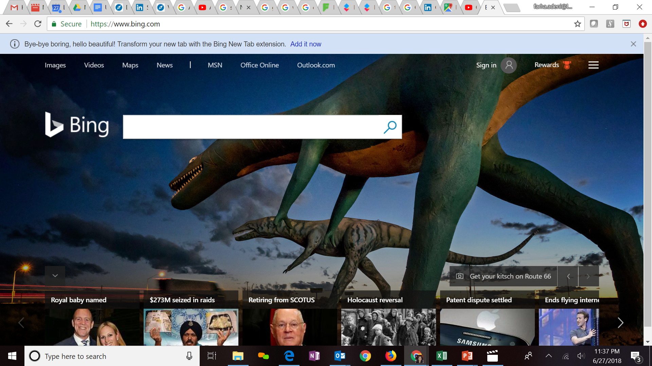







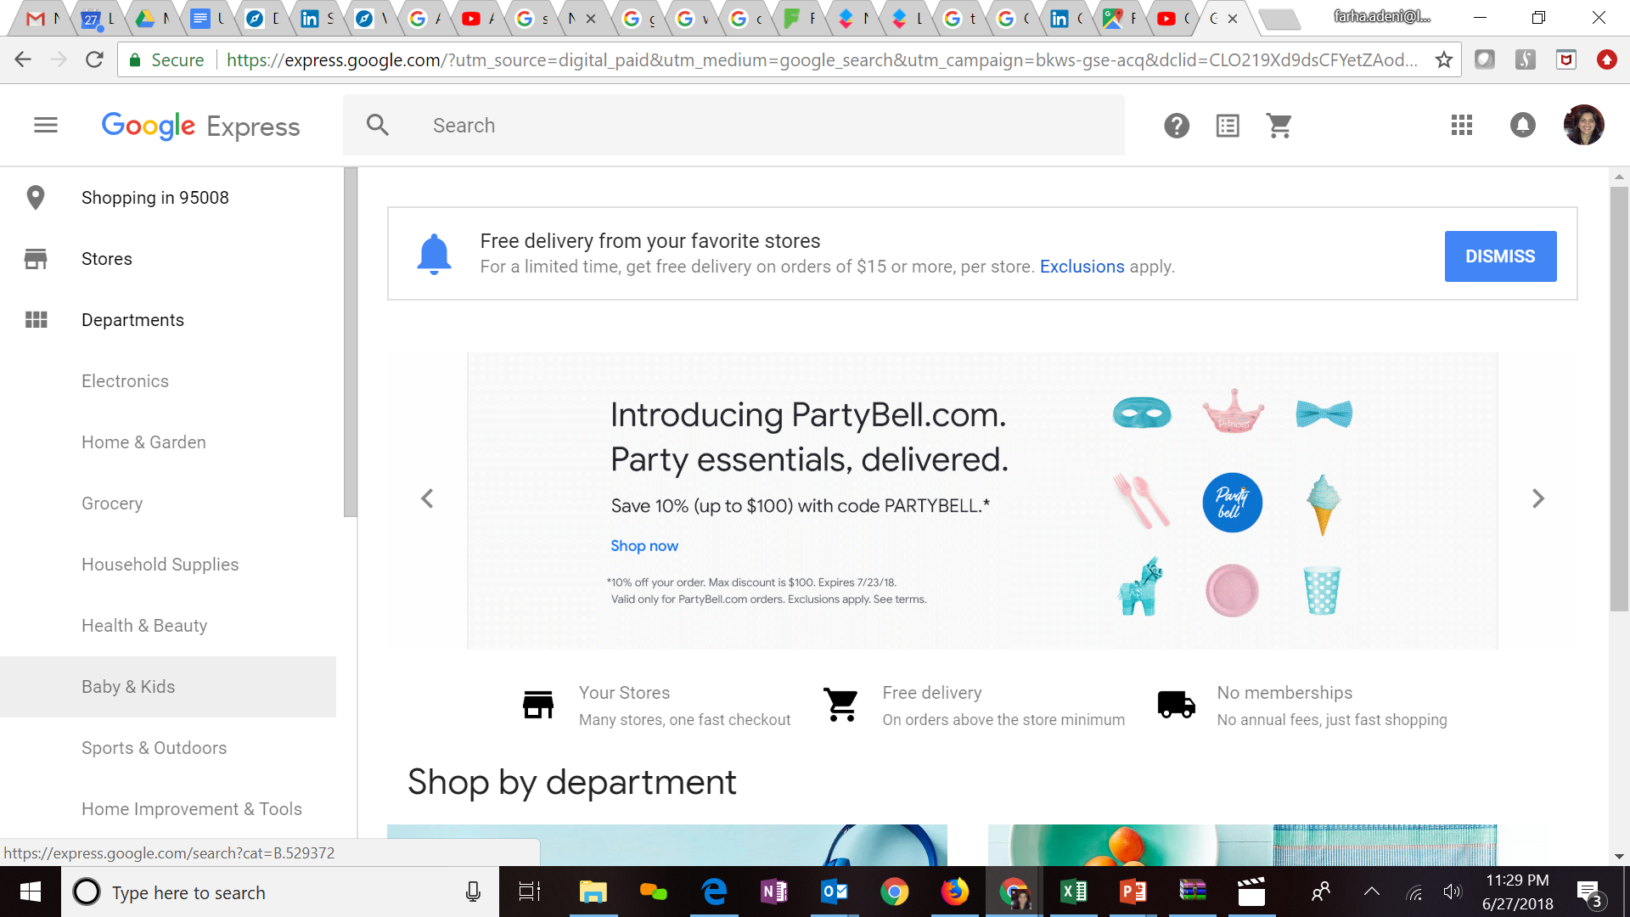
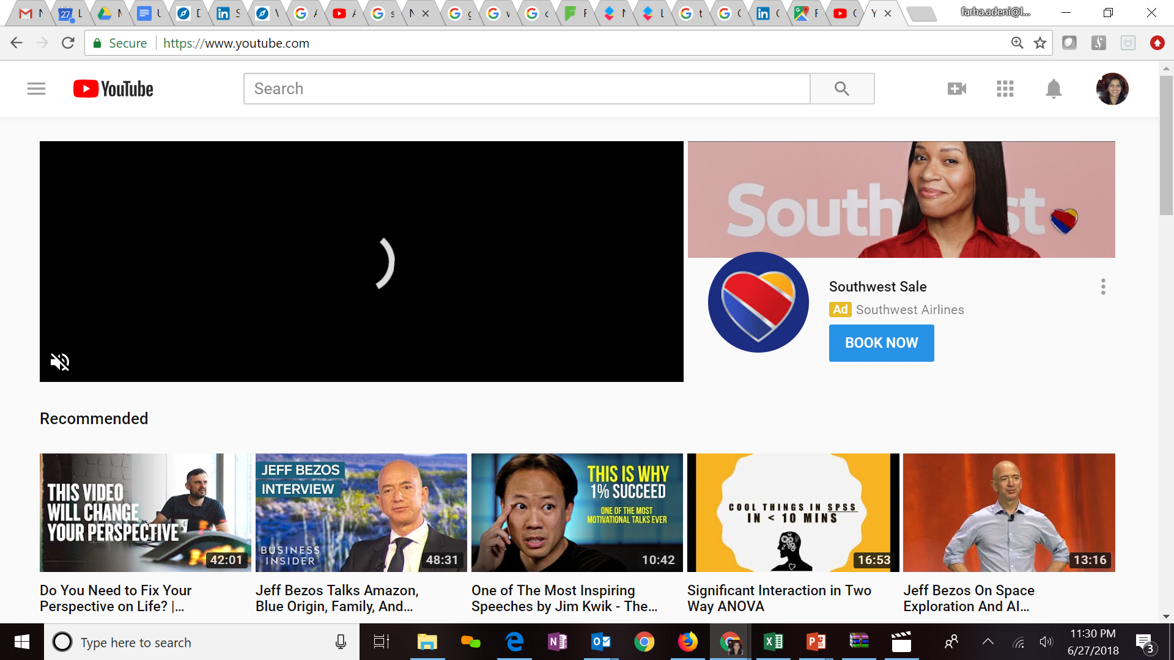
Expertise in Cloud platforms
Key Clients
LatentView is a Microsoft Gold Analytics Partner
Model Automation Framework – LatentView scalable ML solution built in Azure hosted on Microsoft Appsource (link)
Key Participants of MS Tech-ED 2014, Azure Training
Managed Analytics in Azure using AzureML, PowerBI, Azure data factory, Azure Search, Azure data lake analytics etc.
LV is Advanced Analytics Consulting Partner
Key Presenters of AWS Re-Invent, Business Summit
60 TB cloud migration exercise completed in 3 months
Processing 500+ GB unstructured data per week
Multiple enterprise solutions deployment experience
Managed Analytics in AWS using Amazon ML, Cloudsearch, Kinesis, QuickSight etc.
Extensive experience in handling GCP products- AppScript, CloudSQL, Appmaker, Big Query etc. Deep Technical Capabilities to work in this platform
Multiple solutions deployment experience for Google projects
Managed Analytics in GCP using MapR, Cloud ML, Cloud dataflow, Google data studio, Cloud SQL
Notes:
Q – Anup can you update some of the details

